Slide 1

Internship Summer 2014
Kaila Manca
Notes:
Hello everyone, so glad to have you all here. It’s such an honor to have been given the opportunity to work with so many great people, and I will miss this summer dearly. I can’t believe it’s already over!
Now, I don’t know that there was a clear directive for my talk here today, and I understand that this sort of presentation isn’t standard for an intern. However, I would like to take this opportunity to talk a little bit about UX, about my experience here at Tyler, what I’ve learned and how I’ve been able to apply my knowledge within the company.
I thought I would start with a little intro to UX in general, and my expectations when I first arrived.

Slide 2
Industrial Design
Information Architecture
User Interface Design
Sociology
Communication Design
Interaction Design
Tech-Human Mediation
Computer Science
Psychology
Human Factors Design
Anthropology
Product Engineering
Cognitive Science
Researchers
Ergonomics
Visual Design
Graphic Design
Professional Brainstorming
Content Strategy
Notes:
When I first interviewed with Greg Savard for this position, I remember asking him “What does UX mean to your company?”
He might have thought that was a pretty stupid question for someone interviewing for a UX position- I want the job but I don’t know what you do!
BUT my point in asking it was this- UX has become one of those weird tech “buzzwords,” and companies (in my experience) seem to attribute different job titles to UX’ers, based on how their company operates and the culture and environment they cultivate. This slide is compiled entirely from a wikipedia search of “User Experience design,” and lists every other combined field that could be considered a subcategory or influencer of UX. That’s a ton of fields! I didn’t want my position here to be ambiguous, I wanted a clear cut directive, and that’s what Tyler gave me.

Slide 3
UX Design Methods
Step One
Research
Concepting
Prototyping
Designing
Creating
All of the above
Step Two
Step Three
Development
Notes:
Though there are strategies everywhere about HOW UX works, each of them (based on my research) seems to boil down to the above job components.
There is usually some aspect of research involved. Even if the Uxer isnt researching, they are getting research from somewhere- maybe someone else in the company, or from articles online from people who are conducting it. In strong UX companies (my personal opinion) the UX team takes their company’s product and tests it specifically, rather than applying design strategies that may apply to the field of usability. The best companies seem to use both.
The second stage of the UX design field can be broken into separate parts, but to me they are one- concepting, prototyping, designing. Depending on the project, I did these in various orders throughout the summer, but this step was there for every project I completed. Turning research into something useful.
A final aspect of UX that may or may not come into play is involvement in product development. I was lucky enough to have the opportunity to work with awesome developers, and work on the front-end dev for several dynamic programs here at Tyler. I’ll go into those a little later.

Slide 4
Summer Projects
Financials (Jason Quint)
Central Budget Entry
Grant Manager
Project Central
Accounting Entries
Milestones
Recurring Journal Entry
Budget Roll/Factor Merge
Chart of Accounts Builder Dev Assistance
Centrals (Joe Paolino)
Budget Scenarios
Research
HTML/CSS styles for Tyler Pattern Library
New Technology (Jeremy Randall)
Town Council Program
Testing: Lean UX vs. “Quick UX” vs. Traditional UX
Notes:
Not going to include proposal because that didn’t end up being a complete list of work
Once I had done lots of initial research, got started on these programs.
Now, I’m going to do my best to make this presentation cohesive and not jump back and forth too much for you guys, but feel free to speak up and I’ll answer any questions you might have. Let’s dive in with the first step in the UX process… research.

Slide 5
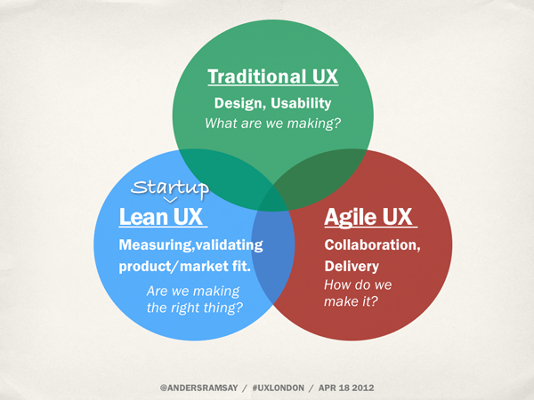
Three Approaches to UX Design
Town Council App
Budget Roll Factor Merge
Financial Apps
Notes:
Agile is “hot food served quickly” – Ward Cunningham, one of the original signatories of the agile manifesto.
If that’s the case, then Traditional is a gourmet meal, that takes an entire day to prepare. It would be whatever the chef decided on for a menu that morning.
Lean would be somewhere in between. It would be an organic, local, delicious, meal, that takes about thirty minutes of prep time. BUT it would be whatever meal you had requested.

Slide 6
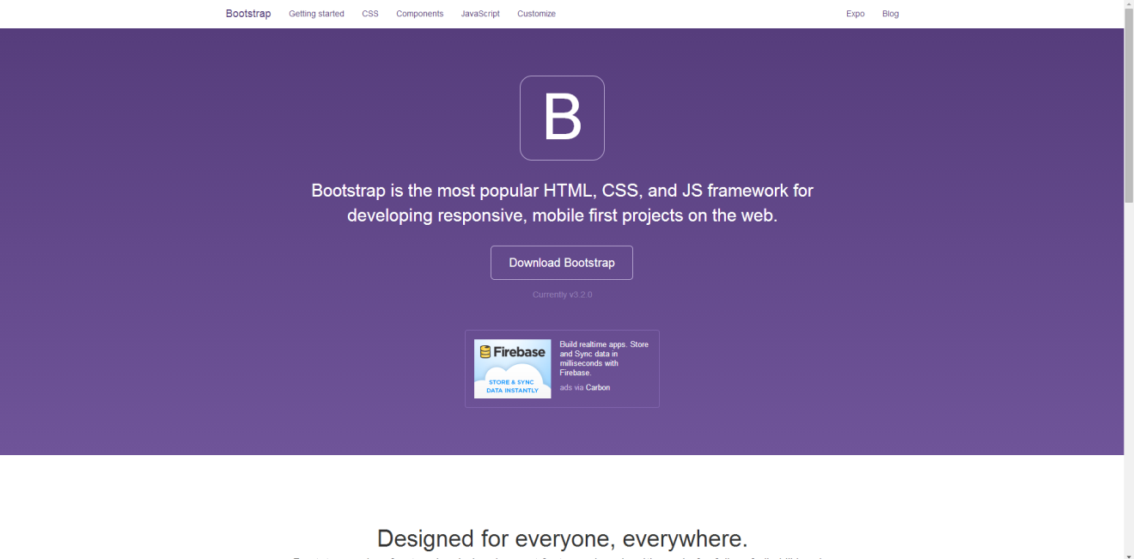
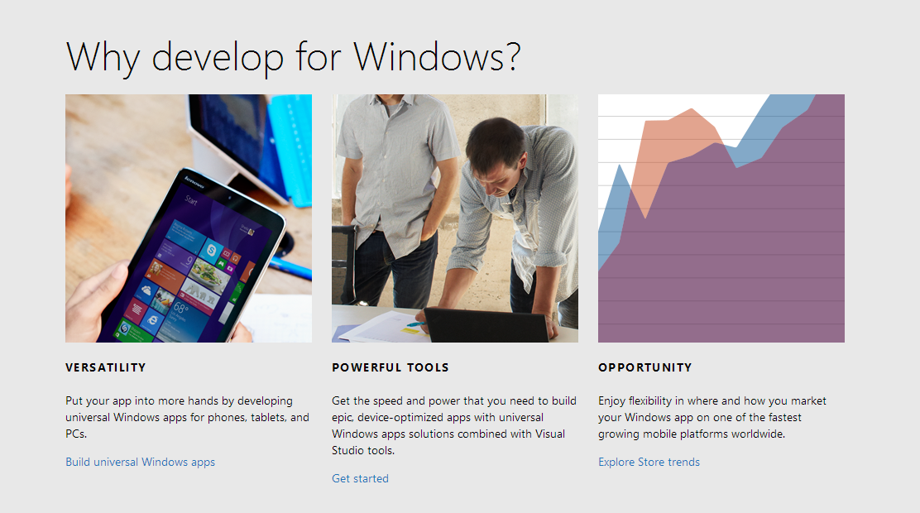
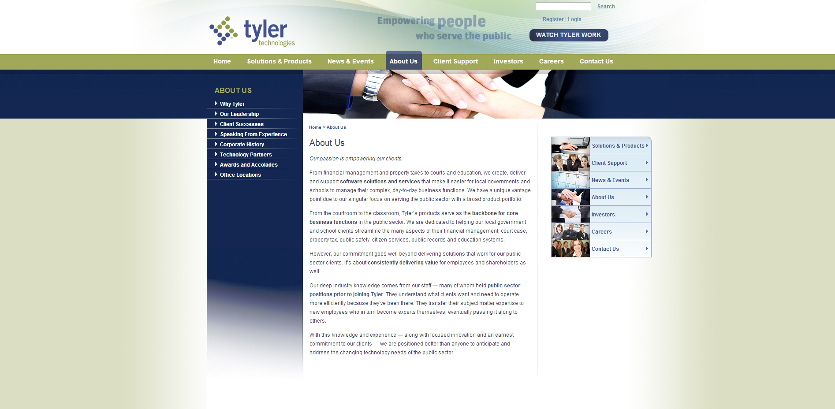
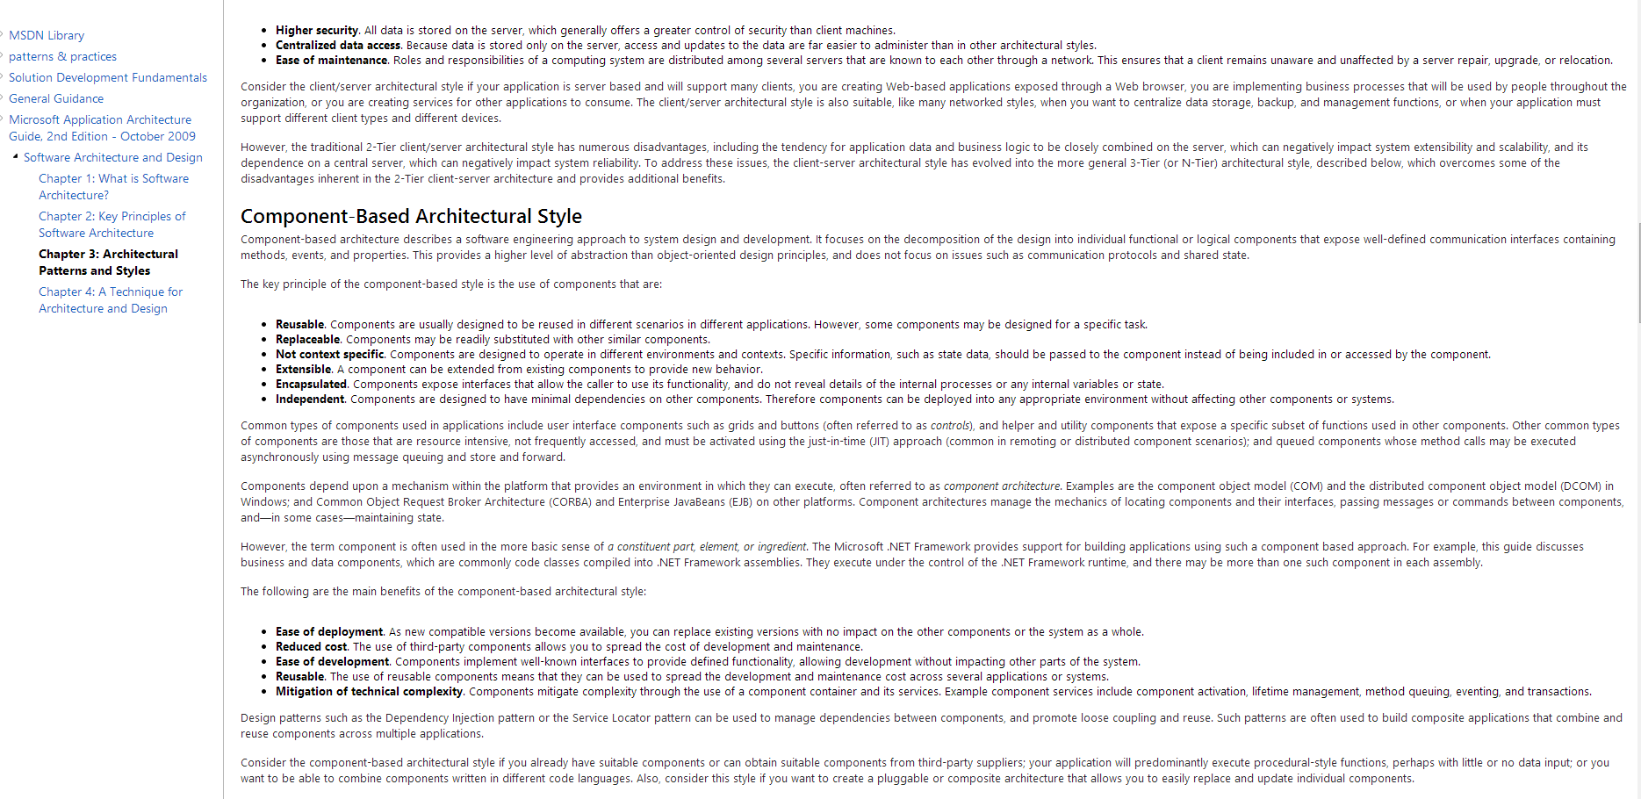
Research Step One
Notes:
Day one at Tyler, I figured out quickly that I’d better get with the program. I didn’t know much about the company, I wasn’t (super) familiar with Bootstrap, I own a Mac and not a Windows computer (waiting for groans)… I know, programming on a Mac, right? Sheesh.
Well, I realized that I had a lot to learn. So I started reading the UX/UI documentation for Microsoft, and talking to the UX team about our design standards. I found out where people were needing UX help through some of the UX team, and I wrote up a proposal for Greg that stated what I thought I could accomplish by the end of my summer here.

Slide 7
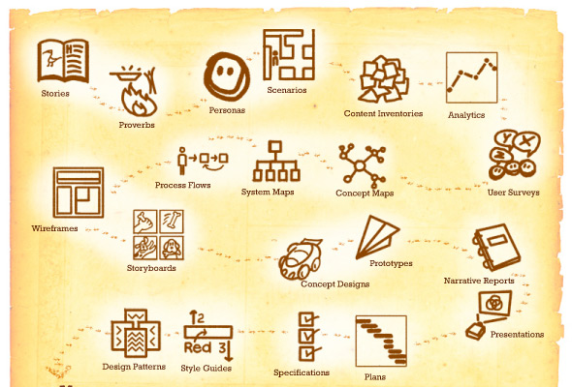
Three Approaches to UX Design
1. The “Traditional Approach”
Town Council App
Research: Mental model, Concept model, Persona
Design: Flows, mockups of sitemap and wireframes.
Low-level prototype, high-level prototype, several iterations.

Slide 8
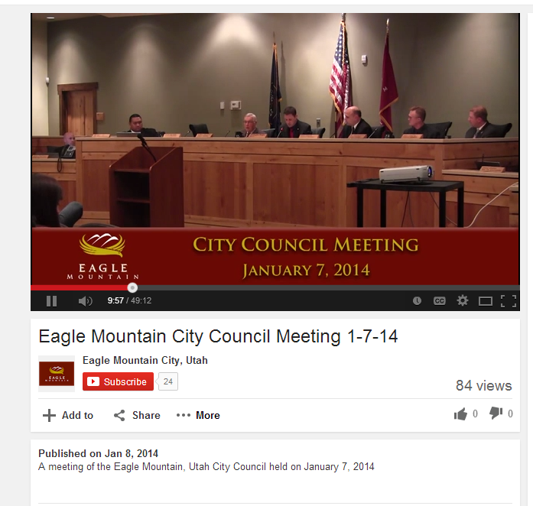
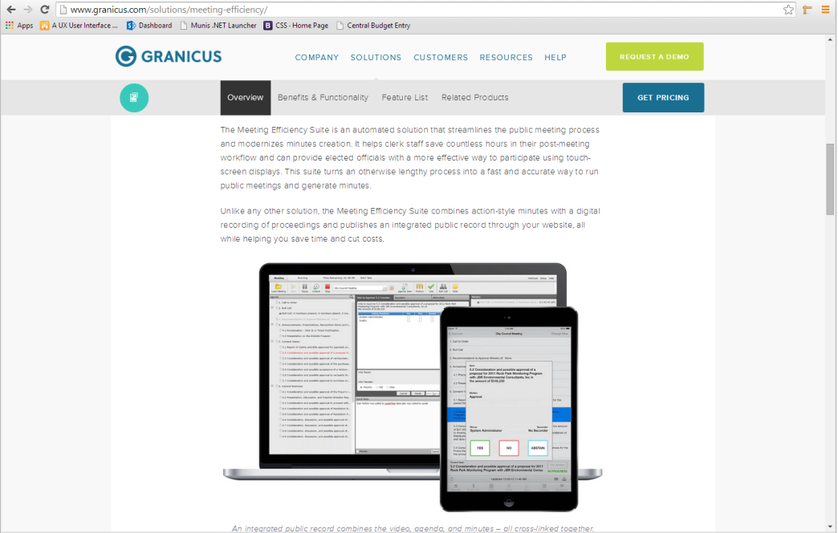
Research: Town Council Project
To Understand User Needs:
Site visit (watch videos)
Research Competitive Software
Analysis of Similar Systems
Design Principles (Specs)
Create
Mental Model
Concept Model
Personas (Secretary, Council Members, General Public)
Notes:
Understand user needs-
Watched videos on town council, identified areas that may assist members
i.e. ability to view agenda digitally, provide info on who is speaking, live updates of the voting, ability for council members to vote using their tablet and our software, easy information on each of the council members and their political history, notetaking features.
Do you want to import the agenda into this program? Do you need to export that data later? How can we make it easily published on the town website?
Took the traditional approach to understanding user needs: created persona and mental model.

Slide 9
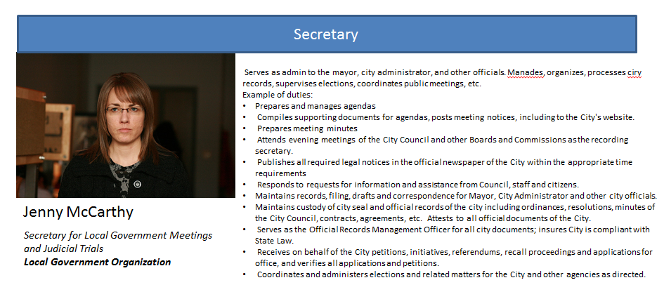
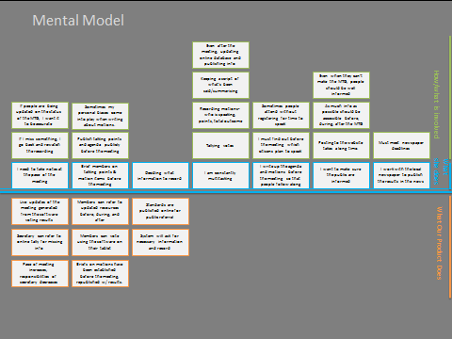
Research: Town Council Project
Needs
Town council information
Job efficiency
Agendas
Political history
Voting ability/tracking
Town Media
Roll call
Ability to take notes
Export/Import data
Notes:
Understand user needs-
Watched videos on town council, identified areas that may assist members
i.e. ability to view agenda digitally, provide info on who is speaking, live updates of the voting, ability for council members to vote using their tablet and our software, easy information on each of the council members and their political history, notetaking features.
Do you want to import the agenda into this program? Do you need to export that data later? How can we make it easily published on the town website?
Took the traditional approach to understanding user needs: created persona and mental model.

Slide 10
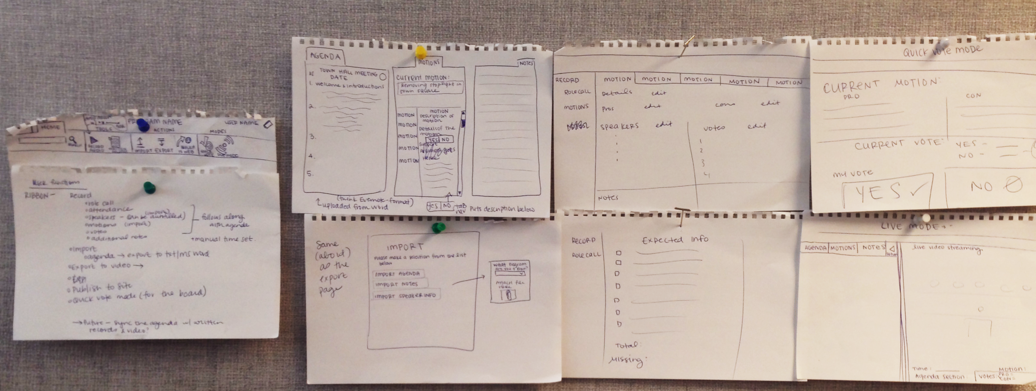
Low-Level Prototype
Notes:
Getting down basic ideas on paper, main screens for live mode, record mode, notetaking, roll call.
Iteration One

Slide 11
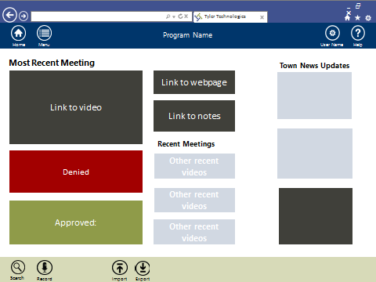
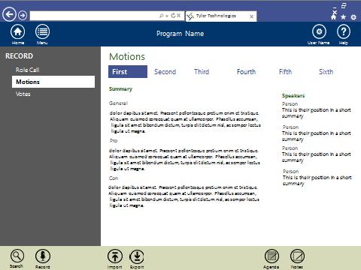
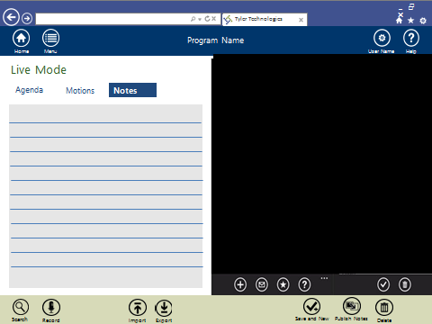
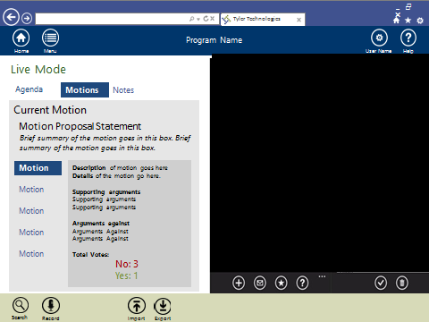
Mid-Level Prototype: Tyler Patterns

Slide 12
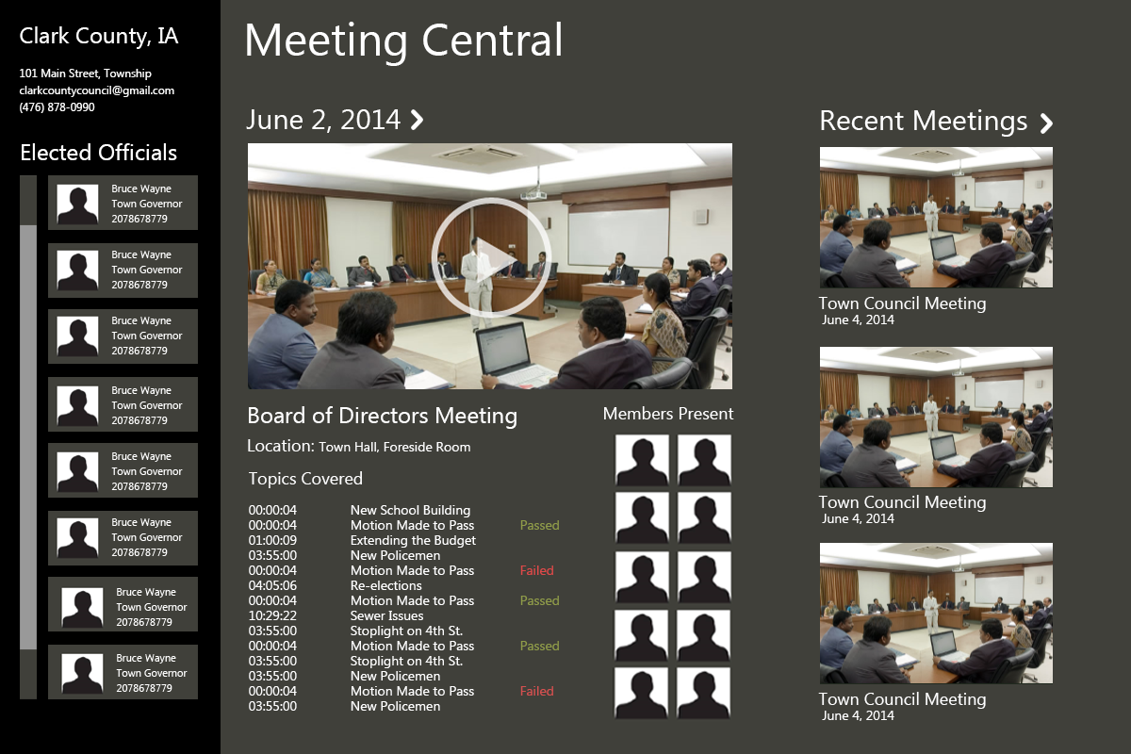
High-Level Prototype: Windows/Tyler Hybrid

Slide 13
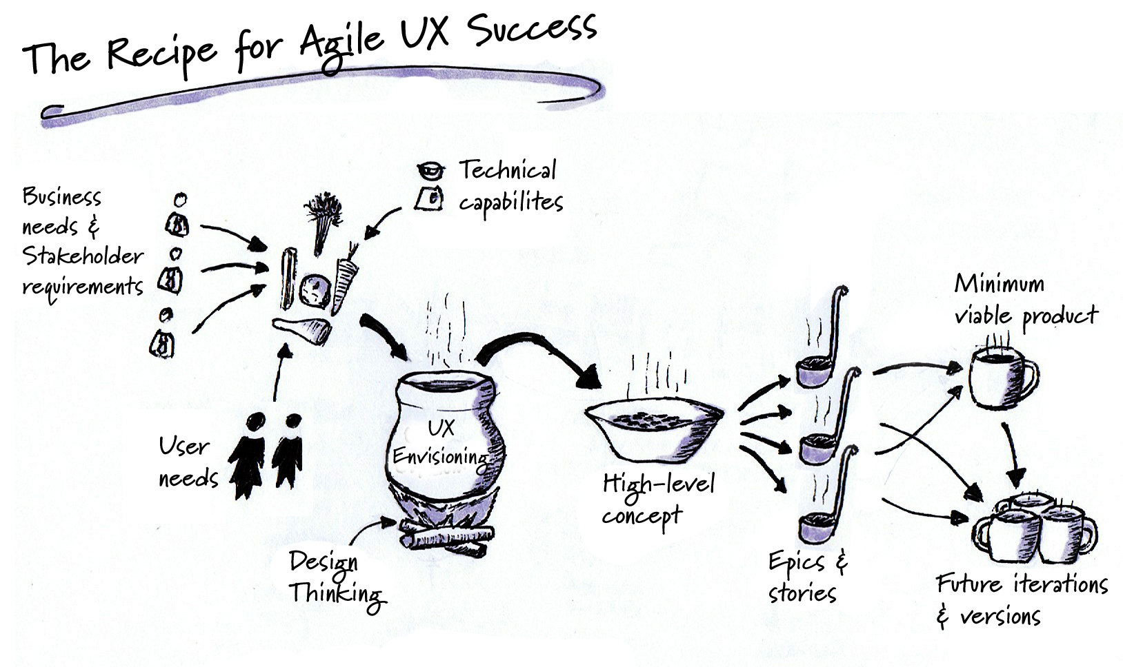
2. The “Quick/Agile-Based” Approach
Financial Programs
(Joe’s Budget Scenarios & Jason’s Programs)
Research: Understood background, looked for areas of improvement
Design: Flow, High-level prototype
Notes:
Cue highlights reel

Slide 14
Financial App Process
Step One: Researching
Took background research about topic & talked to development and support
Discussed any further questions with the project manager & development team
Step Two: Designing
Applied UI design changes
Reiterated

Slide 15
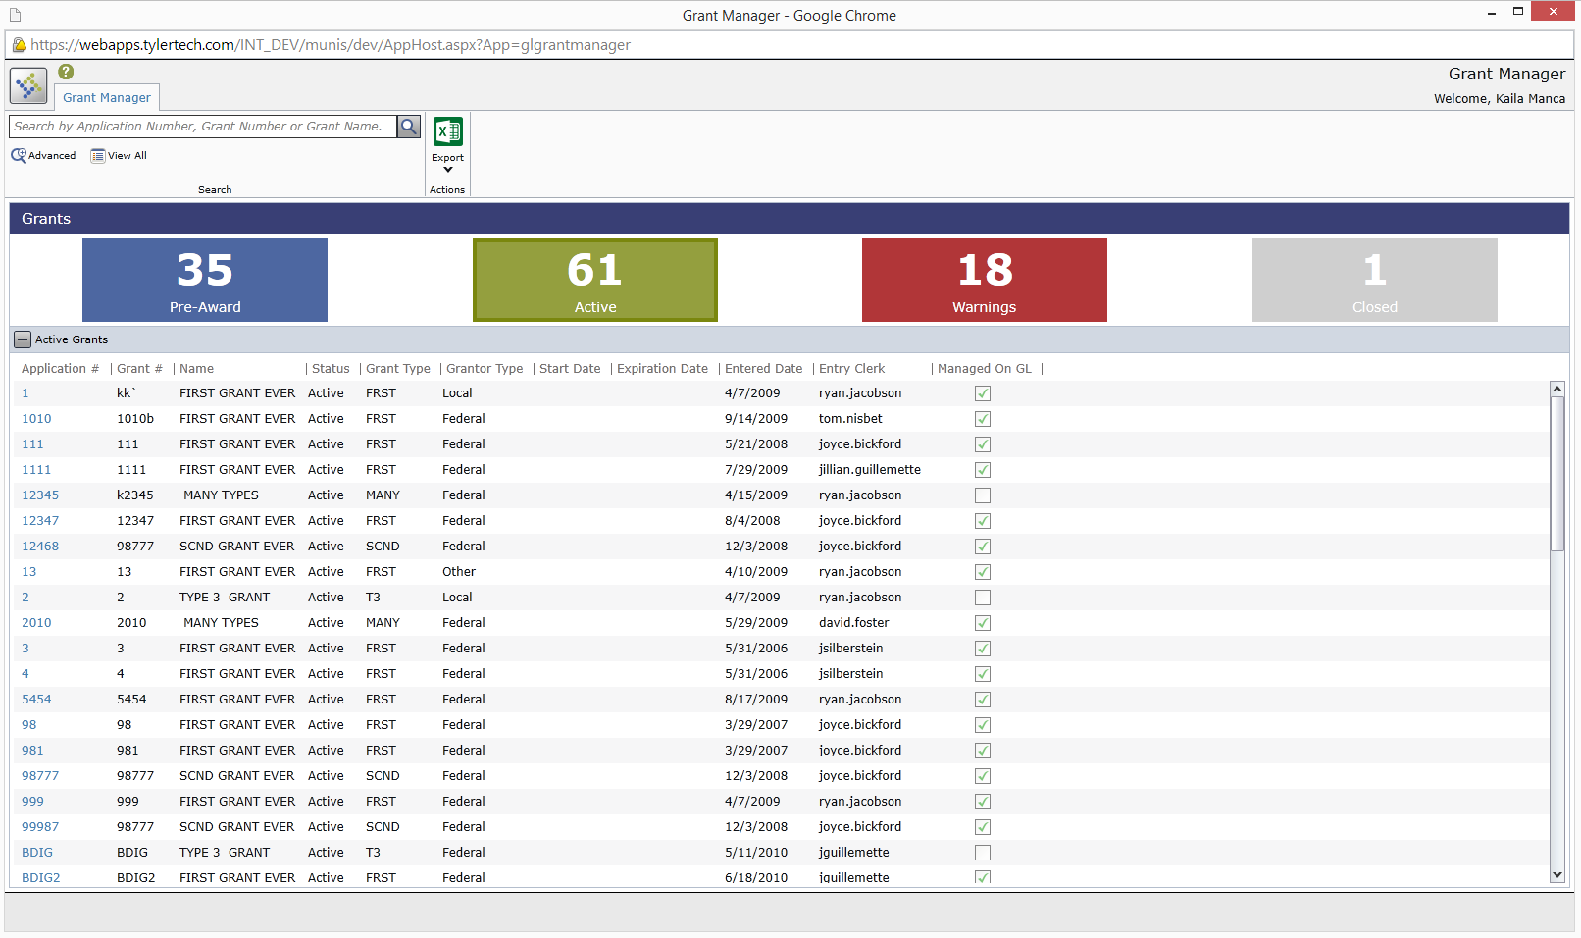

Slide 16
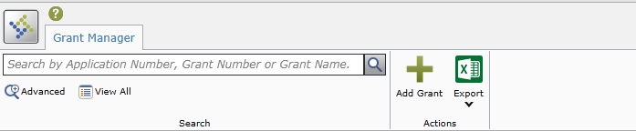
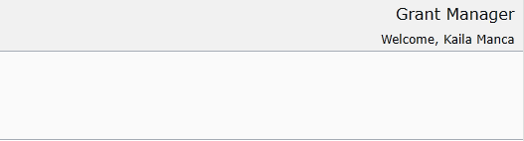
Filter
Grants
Status
Pre-Awarded
Active
Warnings
Closed
15
25
8
12
Application No. | Grant No. | Name | Status | Grant Type | Grantor Type | Entered Date | Entry Clerk | Managed
1 | KLK | Many types | Active | First | Local | 4/7/2009 | David.foster
11 | 1010 | First Grant | Active | Many | Local | 5/6/2010 | Ryan.jacobson
1111 | 11 | Type 3 Grant | Closed | Second | Federal | 12/12/2015 | Jsilberstein
1 | KLK | Many types | Active | First | Local | 4/7/2009 | David.foster
11 | 1010 | First Grant | Active | Many | Local | 5/6/2010 | Ryan.jacobson
1111 | 11 | Type 3 Grant | Closed | Second | Federal | 12/12/2015 | Jsilberstein
1 | KLK | Many types | Active | First | Local | 4/7/2009 | David.foster
11 | 1010 | First Grant | Active | Many | Local | 5/6/2010 | Ryan.jacobson
1111 | 11 | Type 3 Grant | Closed | Second | Federal | 12/12/2015 | Jsilberstein
Notes:
Simple design

Slide 17
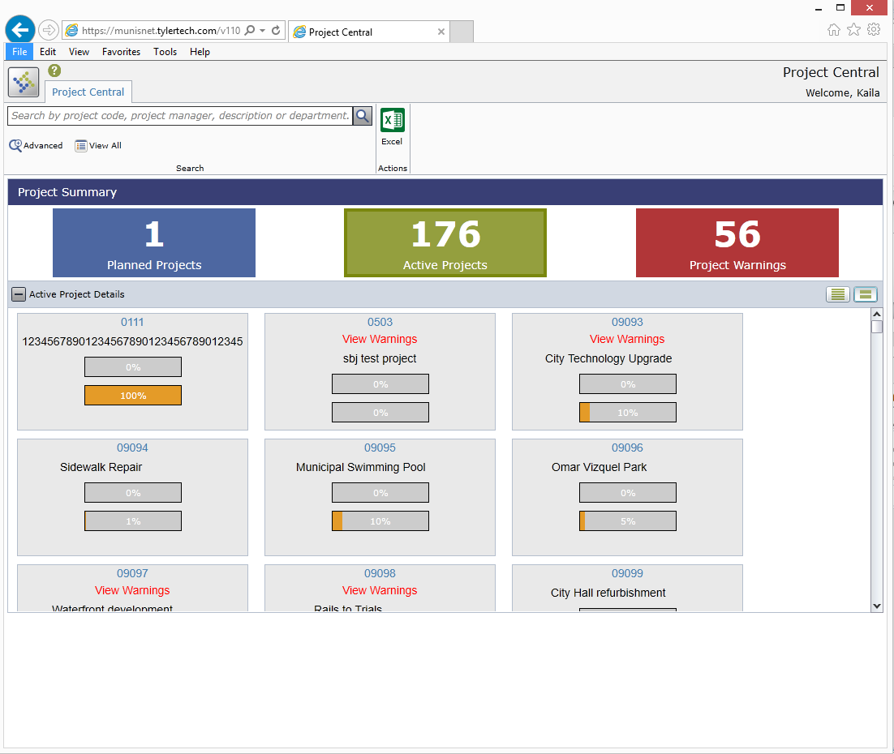

Slide 18
Project Central
Project Central
Filter
Project Central
Status
Planned
Active
Warnings
15
25
8
Details
Account Number
Account Number
Account Number
Account Description here
Account Description here
Account Description here
View Warnings
Notes:
Home with tiles

Slide 19
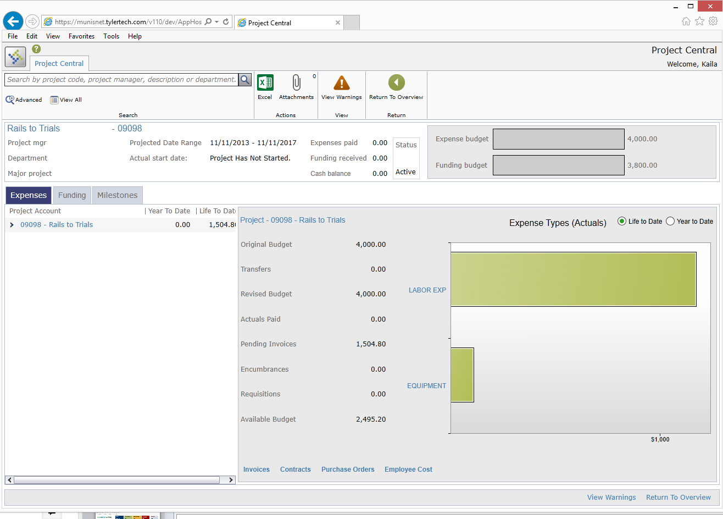
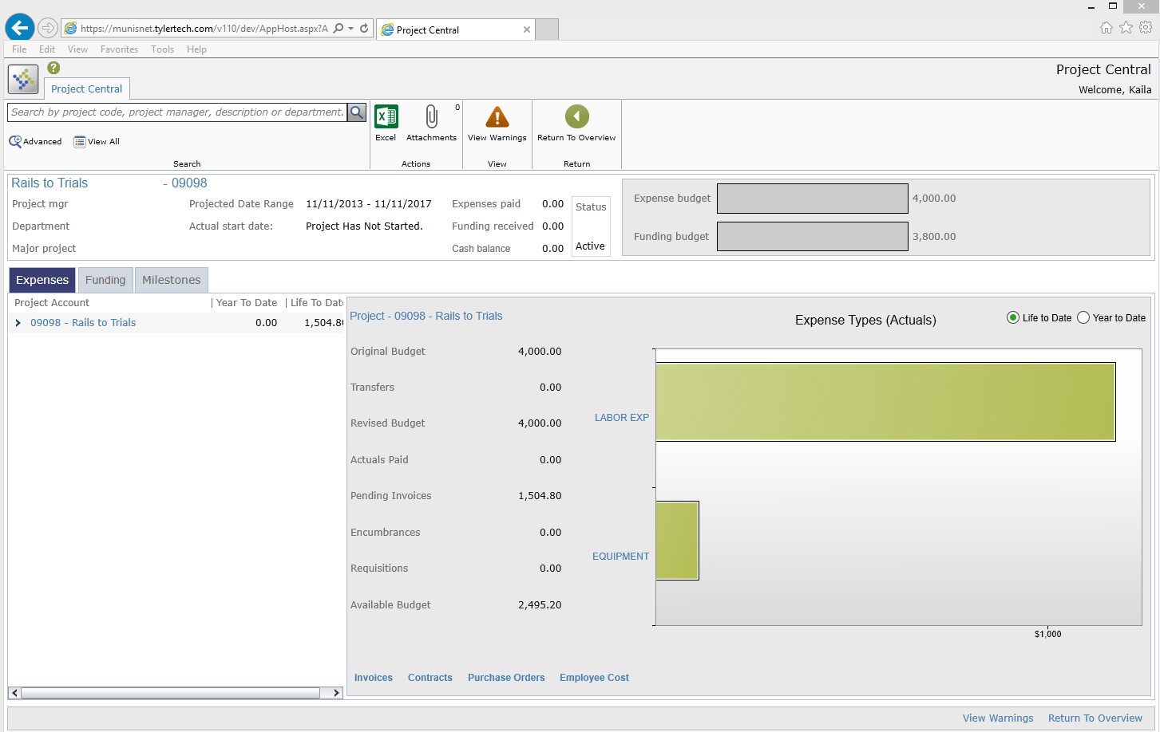

Slide 20
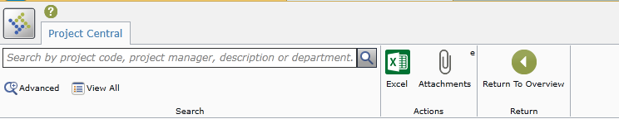
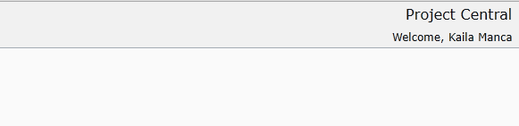
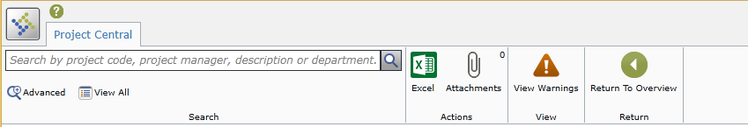
Graph Overview
Graph Overview
Project Identification Number
Summary
Project MGR |  | Projected Data Range | 09/01/2001-07/19/2012 | Expenses Paid | 14,209.95
Department | Plan G | Actual Start Date | 09/01/2001 | Funding Received | 0.00
Major Project | 34930458490 | Status | Active | Cash Balance | -14.209.95
Expenses
Funding
Milestones
Project Account | Year to Date | Life to Date
- 09097-Waterfront Development | 0.00 | 16,497,234
- 100-Planning | 0.00 | 16,497,234
+ 10-Permits | 0.00 | 16,497,234
- 010-Drawings | 0.00 | 16,497,234
09097 .100 .010 | 0.00 | 16,497,234
Task 09097 .100 .010
Original Budget | 7,500.00
Transfers | 0.00
Revised Budget | 7,500.00
Actuals Paid | 0.00
Pending Invoices | 5,530.80
Encumbrances | 0.00
Requisitions | 0.00
Available Budget | 1,962.20
Invoices
Employee Cost
Contracts
Purchase Orders
Notes:
WITHOUT GRAPH IN TOP HEADER, addition of button

Slide 21
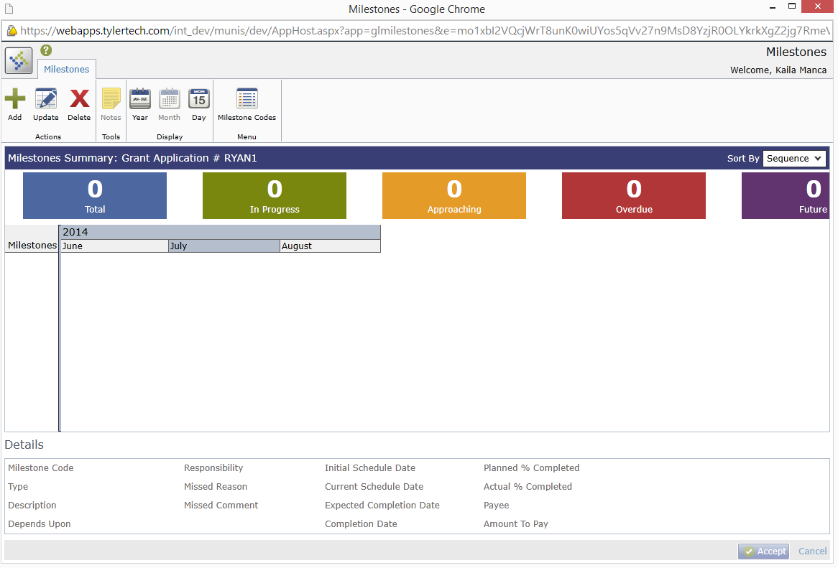

Slide 22
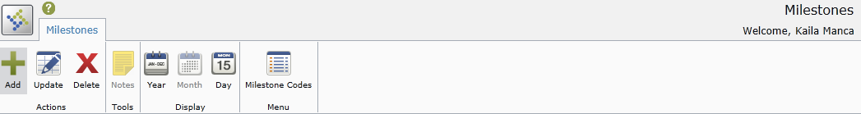
84
1
2
Total
In Progress
1
Future
Approaching
0
Overdue
Milestones Summary
Grant Application #323459
< December 2014 >
Sun | Mon | Tues | Wed | Thurs | Fri | Sat
1 | 2 | 3 | 4 | 5 | 6 | 7
8 | 9 | 10 | 11 | 12 | 13 | 14
15 | 16 | 17 | 18 | 19 | 20 | 21
22 | 23 | 24 | 25 | 26 | 27 | 28
29 | 30 | 31
Milestones
#90 STRT
#91- STRT Test
2014
Details: Milestone Name #90 STRT

Slide 23
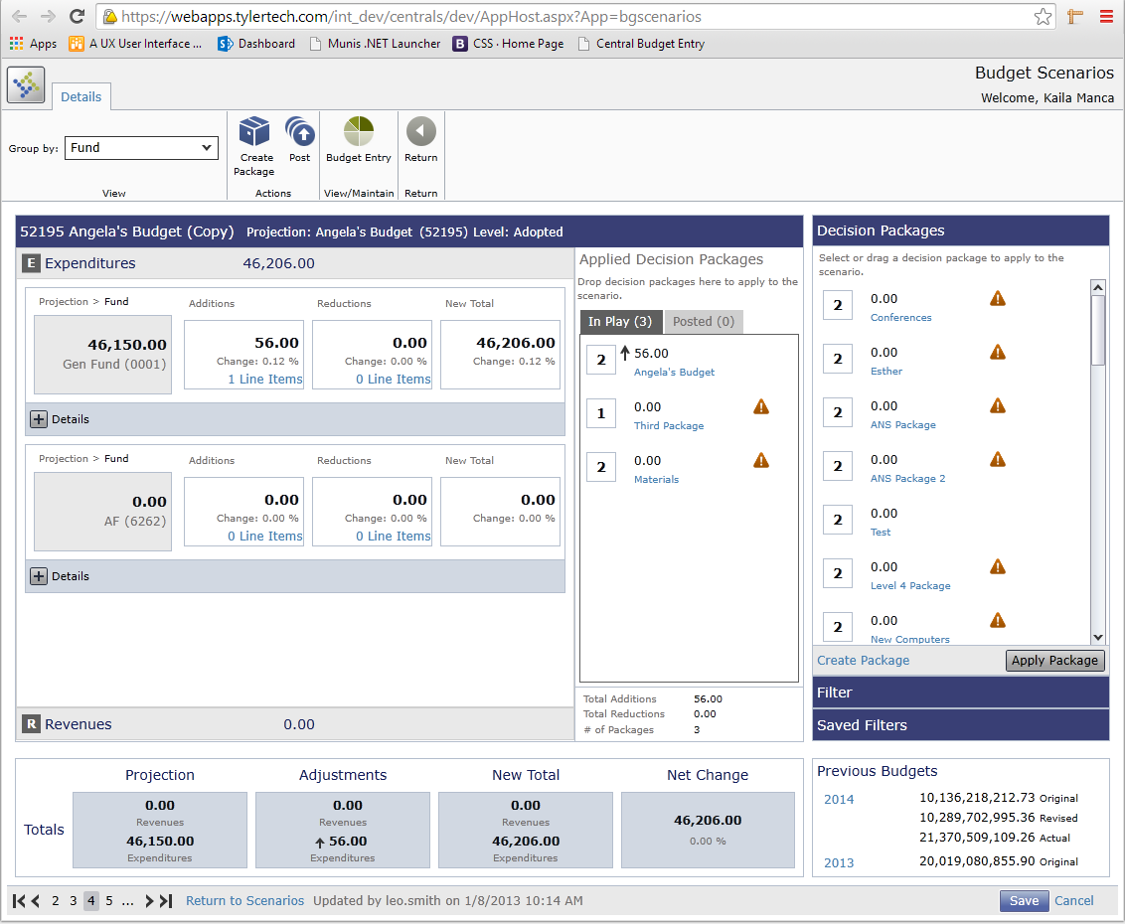

Slide 24

DETAILS
Group by:
Search instruction/hint
Fund
Advanced
Filter
Saved Filter
Create Package
Post
Budget Entry
Previous Budgets
Return
Online Help
Knowledge Base
Actions
View/Maintain
2014 Town Budget Projection 2012 Test Budget Scenarios (71001) Level: Dept
Projection Total | Adjustments Total | Net Totals | Net Change
Revenue 5,816,046.41 | Revenue 67.50 | Revenue 5,815,978.91 | Revenue 2,417,780.61
Expenditures 251,525.00 | Expenditures 251,525.00 | Expenditures 3,398,198.30 | Expenditures 71.15%
Packages
Expenditures/Revenues
Group by:
Fund
Advanced Grouping
Available
In Play
Posted
+ Expenditures (34, 759, 876.98)
+ Revenues (34, 759, 876.98)
250,000.00
New Computers
1
1
250,000.00
New Computers
1
250,000.00
New Computers
1
250,000.00
New Computers
Apply Package

Slide 25
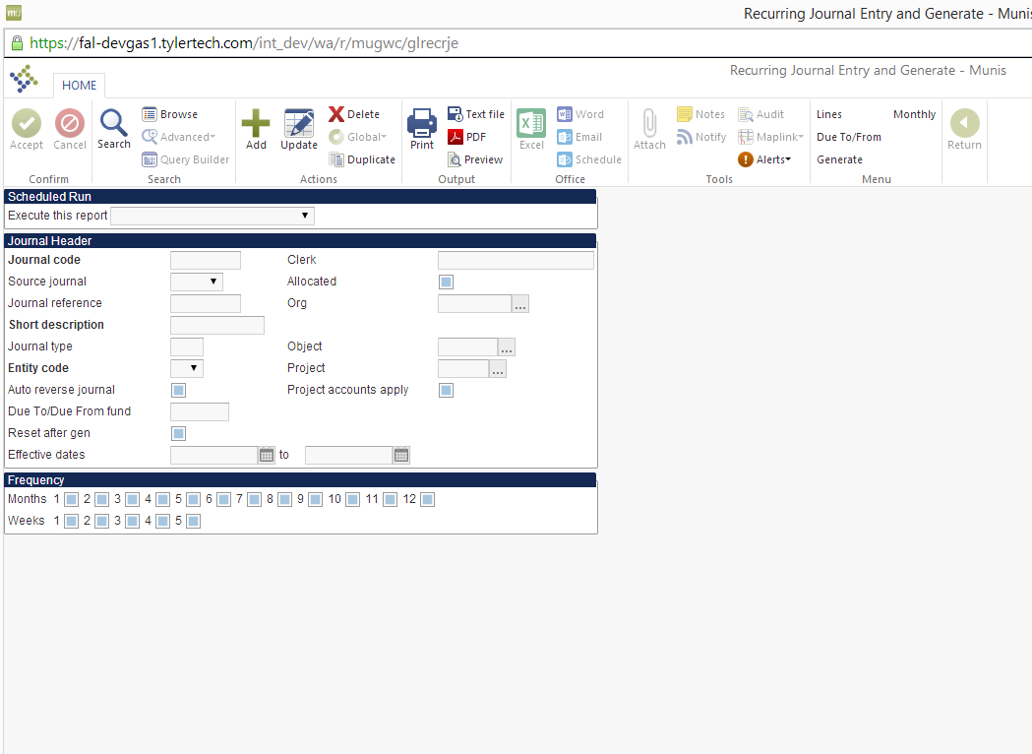

Slide 26
OVERVIEW
Search instruction/hint
Delete
Excel
Print
Due
To/From
Alerts
Lines
Select Columns
Online Help
Knowledge Base
Advanced
Filter
Add
Monthly
Generate
Search
Tools
Output
Help
Browse Journals
Journal Code | Effective Date | Source | Description | Total Debits | Total Credits | Date Created | Actions
75677 | 01/14/2013-09/29/2015 | GEN | Test | 0.00 | 0.00 | 09/29/2015
12222 | 01/14/2013-09/29/2015 | AE | more data | 90.00 | 90.00 | 09/29/2015
94840 | 01/14/2013-09/29/2015 | GEN | Information here | 1,987,000.00 | 1,987,000.00 | 09/29/2015
2222 | 01/14/2013-09/29/2015 | BS | test | 0.00 | 0.00 | 09/29/2015
11 | 01/14/2013-09/29/2015 | GEN | Test | 90.00 | 90.00 | 09/29/2015
1678 | 01/14/2013-09/29/2015 | AE | more data | 1,987,000.00 | 1,987,000.00 | 09/29/2015
0809078 | 01/14/2013-09/29/2015 | GEN | Information here | 0.00 | 0.00 | 09/29/2015
12222 | 01/14/2013-09/29/2015 | BS | test | 90.00 | 90.00 | 09/29/2015
94840 | 01/14/2013-09/29/2015 | GEN | Test | 1,987,000.00 | 1,987,000.00 | 09/29/2015
2222 | 01/14/2013-09/29/2015 | AE | more data | 0.00 | 0.00 | 09/29/2015
11 | 01/14/2013-09/29/2015 | GEN | Information here | 90.00 | 90.00 | 09/29/2015
1678 | 01/14/2013-09/29/2015 | BS | test | 1,987,000.00 | 1,987,000.00 | 09/29/2015
Save
Cancel

Slide 27
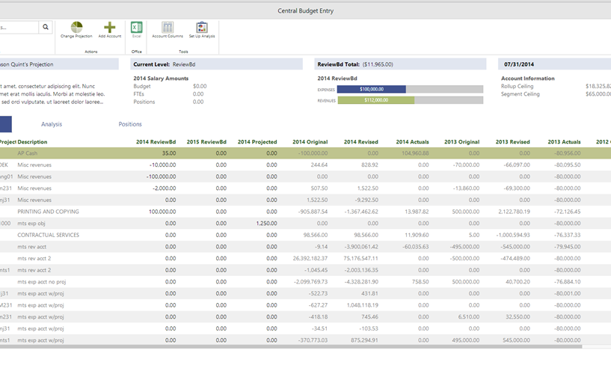
Step 3: Development
Notes:
I was fortunate enough to get to be involved in a third step of the UX process and see some of the designs I’d worked on be implemented, even implementing them myself which was a special treat.
I got to create some new design styles we had come up with during my time here at tyler, create them and modify them in HTML/CSS. I also got to play around with mobile apps during my research into ionic, and to implement different vector fonts and create a coded SVG image while I researched other image types.
Had a few awesome developers to work with: specifically Lisien, John, and Tony. Tony I worked with to iterate on the UI for his program. I wrote some code modifying the bootstrap styles for the Tyler Pattern Library. Lisien and John I offered design assistance- doing everything from creating many brand-new and incredibly frustrating icons, to implementing the design myself by tweaking their layouts and manipulating their code.
Overall, the most exciting aspect of getting to be involved in development was being able to see the programs I was working on change before my eyes. To get to operate on something dynamic, and, as an intern, to know that much of the work you’ve been doing is actually going somewhere, makes a world of difference. I feel like this highlights how unique my opportunities here at Tyler have been.

Slide 28
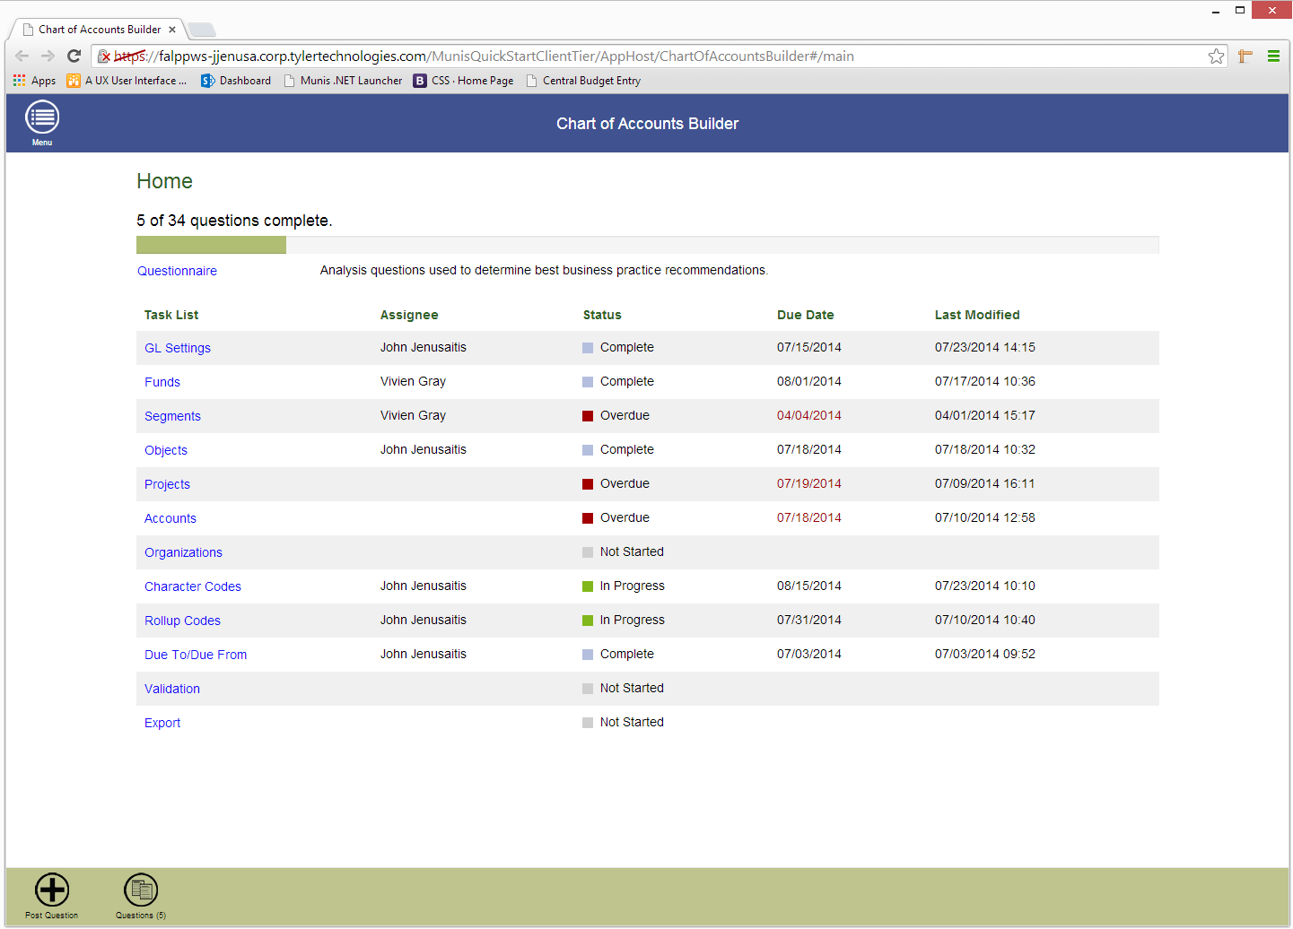
Chart of Accounts Builder

Slide 29
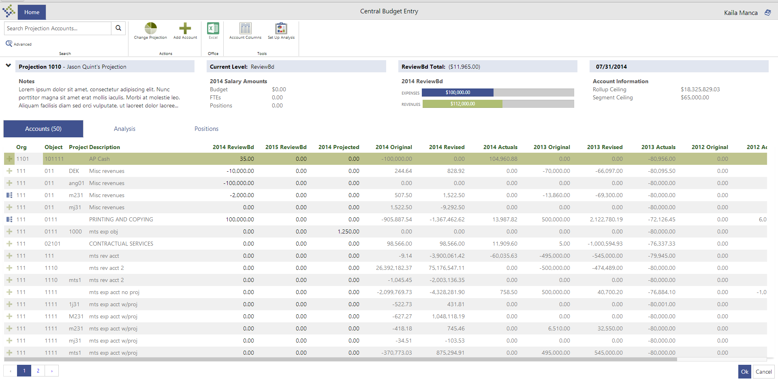
Central Budget Entry

Slide 30
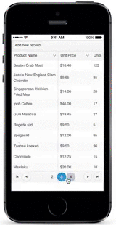
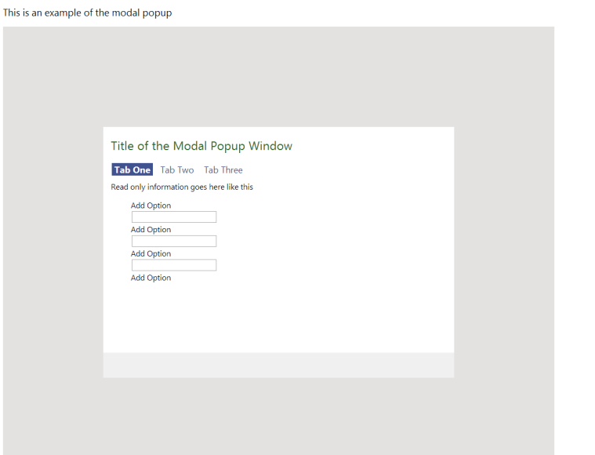
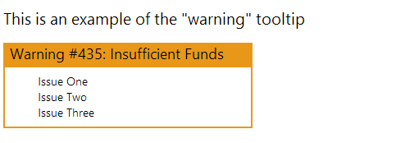
UX Step 3: Development
Code for Tyler PL
Ionic mobile app
Financial team design implementation
Notes:
I was fortunate enough to get to be involved in a third step of the UX process and see some of the designs I’d worked on be implemented, even implementing them myself which was a special treat.
I got to create some new design styles we had come up with during my time here at tyler, create them and modify them in HTML/CSS. I also got to play around with mobile apps during my research into ionic, and to implement different vector fonts and create a coded SVG image while I researched other image types.
Had a few awesome developers to work with: specifically Lisien, John, and Tony. Tony I worked with to iterate on the UI for his program. I wrote some code modifying the bootstrap styles for the Tyler Pattern Library. Lisien and John I offered design assistance- doing everything from creating many brand-new and incredibly frustrating icons, to implementing the design myself by tweaking their layouts and manipulating their code.
Overall, the most exciting aspect of getting to be involved in development was being able to see the programs I was working on change before my eyes. To get to operate on something dynamic, and, as an intern, to know that much of the work you’ve been doing is actually going somewhere, makes a world of difference. I feel like this highlights how unique my opportunities here at Tyler have been.

Slide 31
Three Approaches to UX Design
3. The “Lean UX” Approach
Roll/Factor Merge (and Budget Scenarios)
Notes:
The “Lean UX”
Roll/Factor Merge (and Budget Scenarios)
Research: Understood background Design: Flow, Low-level prototype
Research: Testing
Design: Low-Level Prototype
*Repeat this sequence until you present low-level to PM for approval.
THEN High-Level Prototype

Slide 32
Step One: Research
Minimal – Thinking comes later
No interaction with previous program
No personal UI design implemented
Presented with functionality of program
Purpose/what does it do?
What does the user expect to gain from it?

Slide 33
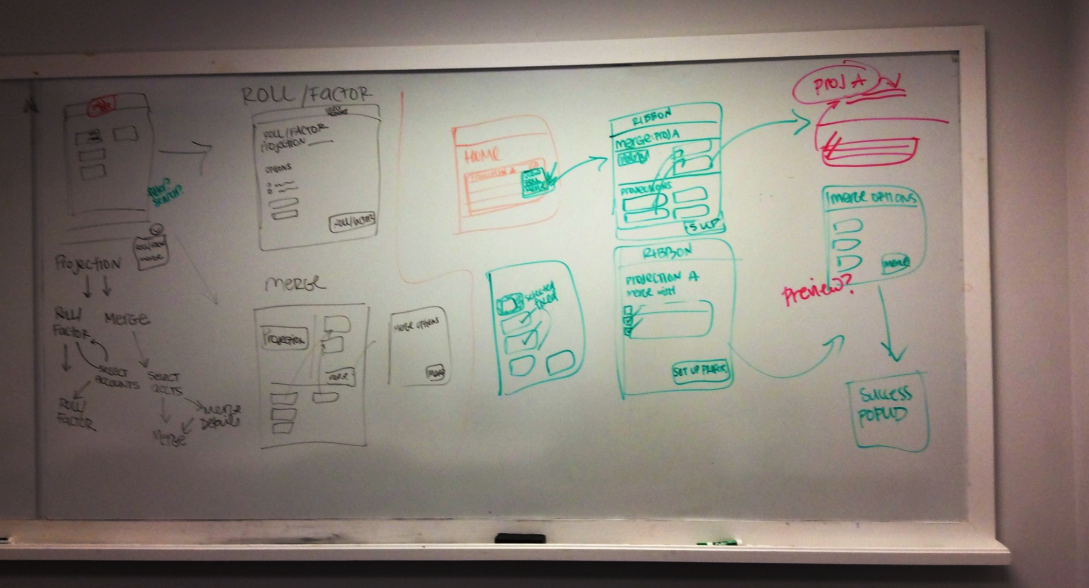
Step Two: Prototyping & Testing
Quick Mockup: Version One

Slide 34
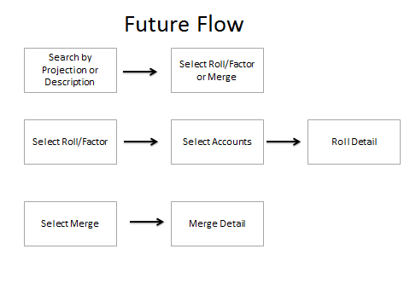
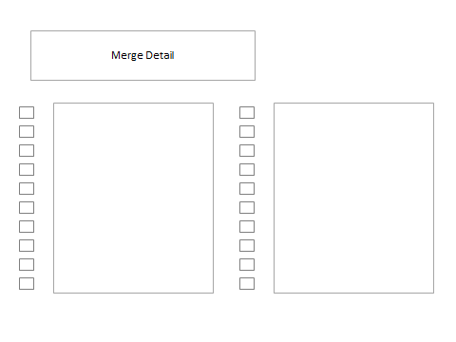
Step Two: Prototyping & Testing
Quick Mockup: Version Two

Slide 35
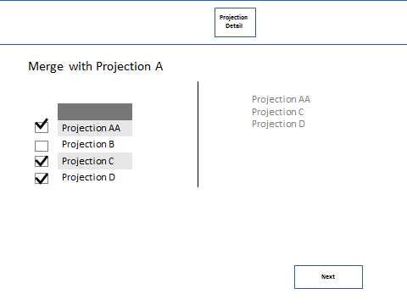
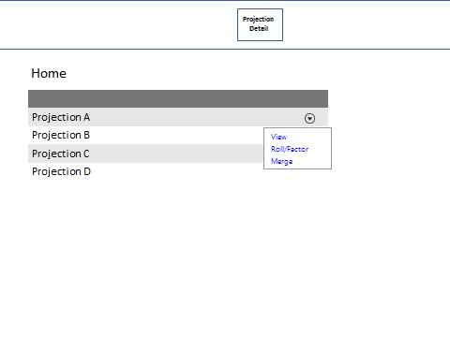
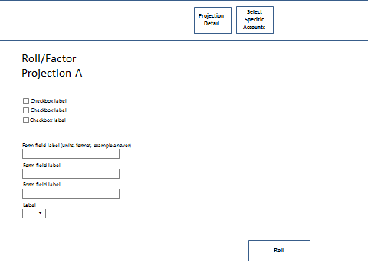
Version Three
Notes:
User feedback: “It needs a lot of work”

Slide 36
Version Three
User Quote:
“It feels like it needs a lot of work.”
Notes:
User feedback: “It needs a lot of work”

Slide 37
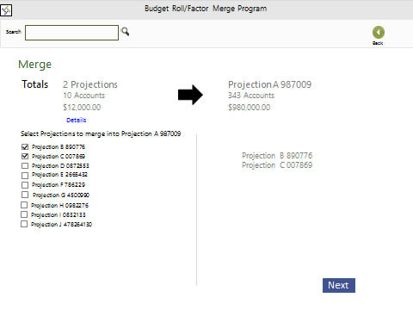
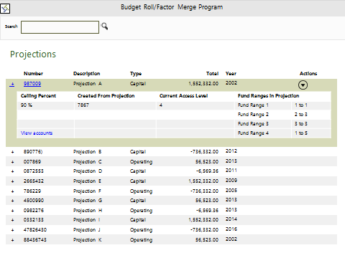
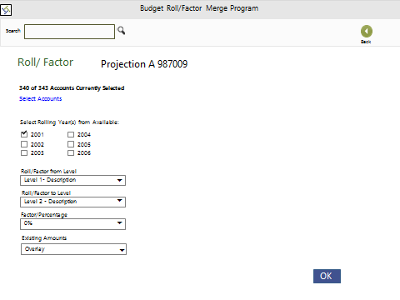
Version Six
Notes:
After version seven we presented to the pm, jason, for his approval. We made some changes, and it was approved to go to a higher level design phase, where it would be considered “final”

Slide 38
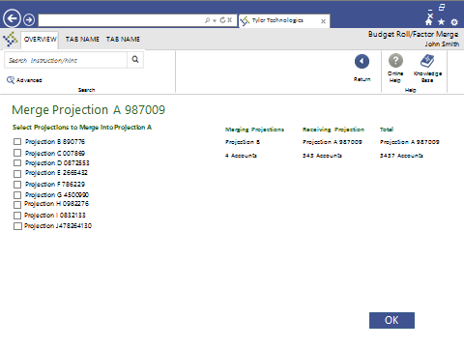
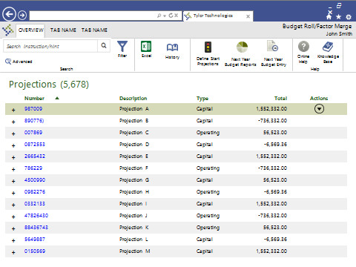
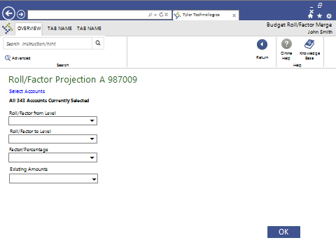
Version Eight
Notes:
“After looking at this, yeah. This is good”

Slide 39
Version Eight
User Quote:
After looking at this… yeah. This is good.”
Notes:
“After looking at this, yeah. This is good”

Slide 40

Wrapping it Up

Slide 41
Lessons from Tyler & My Summer
My Goals:
Involvement in a variety of UX areas
Independence, Career-focus
Potential future workplace
Opportunity to learn
Opportunity to build skillset
Actual, real, applicable… work
Notes:
One other way my time here at tyler has been unique is that I’ve had the opportunity to step foot in so many different domains. I truly was able to run through each step of the typical UX process: research, concept, prototype, test, refine, design. AND develop.
I feel so blessed by my summer here and the opportunities I’ve been given.
Things I thought I’d find were independence, personal motivation (in the sense that I could focus on something career-driven), and a company that I might like to work for when I graduate. Another thing I was looking for in this internship, besides validation that I’ve been preparing for this career in an appropriate way, was the opportunity to learn more, to build my skill set. Now there are constantly areas for improvement, and an endless supply of things to learn- but at Tyler I felt like there were resources to get you there. I’ve gotten all this and more here.
The employees I’ve met have been incredibly kind and eager to assist. Joe Paolino, Jeremy Randall, and Greg Savard acted as steady managers and kind bosses, always willing to chat about Tyler, or their new Xbox, or sea kayaking, or the best local food joints. I got some incredible advice and invaluable insight from these guys. The Project Manager I worked with (and hit the trails with!) most regularly was Jason Quint. He and his team presented me with a steady flow of work to keep me interested and a collaborative and endlessly entertaining environment in which to work. Of all Tyler employees, Esther Keister especially, stepped up and acted as my mentor and friend. She took it upon herself to guide me along this process, tracking my progress and offering assistance and support along the way.
I feel as though I walk away from this summer having learned many skills to add to my repertoire, and having spent my time productively- doing real work for real people. I also have a newfound appreciation for the financial world after coming up with a thousand ways to create new budget scenarios.
At the beginning of the summer, I hope by the end I’d be able to see some beneficial impact of my time here at Tyler. I hope that that’s the case. The small-company feel of this office, and the environment set for the employees really inspires loyalty. Because it’s a place that gives a lot to its employees and encourages life balance, that kept me motivated me to give my all every day.
Personally, I know I’d return to this place in a heartbeat, and I plan on applying for a job here this year.
Thanks for a wonderful summer, Tyler. It’s been a pleasure to meet and work with each and every one of you.

Slide 42

Lessons from Tyler & My Summer
My Goals:
Involvement in a variety of UX areas
Independence, Career-focus
Potential future workplace
Opportunity to learn
Opportunity to build skillset
Actual, real, applicable… work.
+ more!
Notes:
One other way my time here at tyler has been unique is that I’ve had the opportunity to step foot in so many different domains. I truly was able to run through each step of the typical UX process: research, concept, prototype, test, refine, design. AND develop.
I feel so blessed by my summer here and the opportunities I’ve been given.
Things I thought I’d find were independence, personal motivation (in the sense that I could focus on something career-driven), and a company that I might like to work for when I graduate. Another thing I was looking for in this internship, besides validation that I’ve been preparing for this career in an appropriate way, was the opportunity to learn more, to build my skill set. Now there are constantly areas for improvement, and an endless supply of things to learn- but at Tyler I felt like there were resources to get you there. I’ve gotten all this and more here.
The employees I’ve met have been incredibly kind and eager to assist. Joe Paolino, Jeremy Randall, and Greg Savard acted as steady managers and kind bosses, always willing to chat about Tyler, or their new Xbox, or sea kayaking, or the best local food joints. I got some incredible advice and invaluable insight from these guys. The Project Manager I worked with (and hit the trails with!) most regularly was Jason Quint. He and his team presented me with a steady flow of work to keep me interested and a collaborative and endlessly entertaining environment in which to work. Of all Tyler employees, Esther Keister especially, stepped up and acted as my mentor and friend. She took it upon herself to guide me along this process, tracking my progress and offering assistance and support along the way.
I feel as though I walk away from this summer having learned many skills to add to my repertoire, and having spent my time productively- doing real work for real people. I also have a newfound appreciation for the financial world after coming up with a thousand ways to create new budget scenarios.
At the beginning of the summer, I hope by the end I’d be able to see some beneficial impact of my time here at Tyler. I hope that that’s the case. The small-company feel of this office, and the environment set for the employees really inspires loyalty. Because it’s a place that gives a lot to its employees and encourages life balance, that kept me motivated me to give my all every day.
Personally, I know I’d return to this place in a heartbeat, and I plan on applying for a job here this year.
Thanks for a wonderful summer, Tyler. It’s been a pleasure to meet and work with each and every one of you.

Slide 43

Tyler Tech &
all of you, for a fantastic summer!

Slide 44
References
Neeman, Patrick. "How to Kill It in A UX Interview." Usability Counts. N.p., 29 Jan. 2014. Web. June-July 2014.
User Interface Engineering Why Lean UX? Retrieved July 31, 2014 from http://www.uie.com/articles/why_lean_ux
AndersRamsay.com AndersRamsay.com. Retrieved July 31, 2014 from http://www.andersramsay.com/2012/04/24/agile-ux-vs-lean-ux/
Technology First, Needs Last- ind.org Technology First, Needs Last – ind.org. Retrieved July 31, 2014 from http://ind.org/dn/mss/technology first needs last.html

